Slide 1
V-Shaped SDLC Model

Slide 2
Introduction
It means verification and validation .
Just like Waterfall model, the life cycle of V Model is a sequential path of the execution of the process
Each phase must be completed before the next phase begins
The testing of the product is planned in parallel with corresponding phase of the development

Slide 3
Objectives when to use the V-model
It should be used for small to medium size projects where requirements are clearly defined
It should be chosen when simple technical resources are available with needed technical expertise

Slide 4
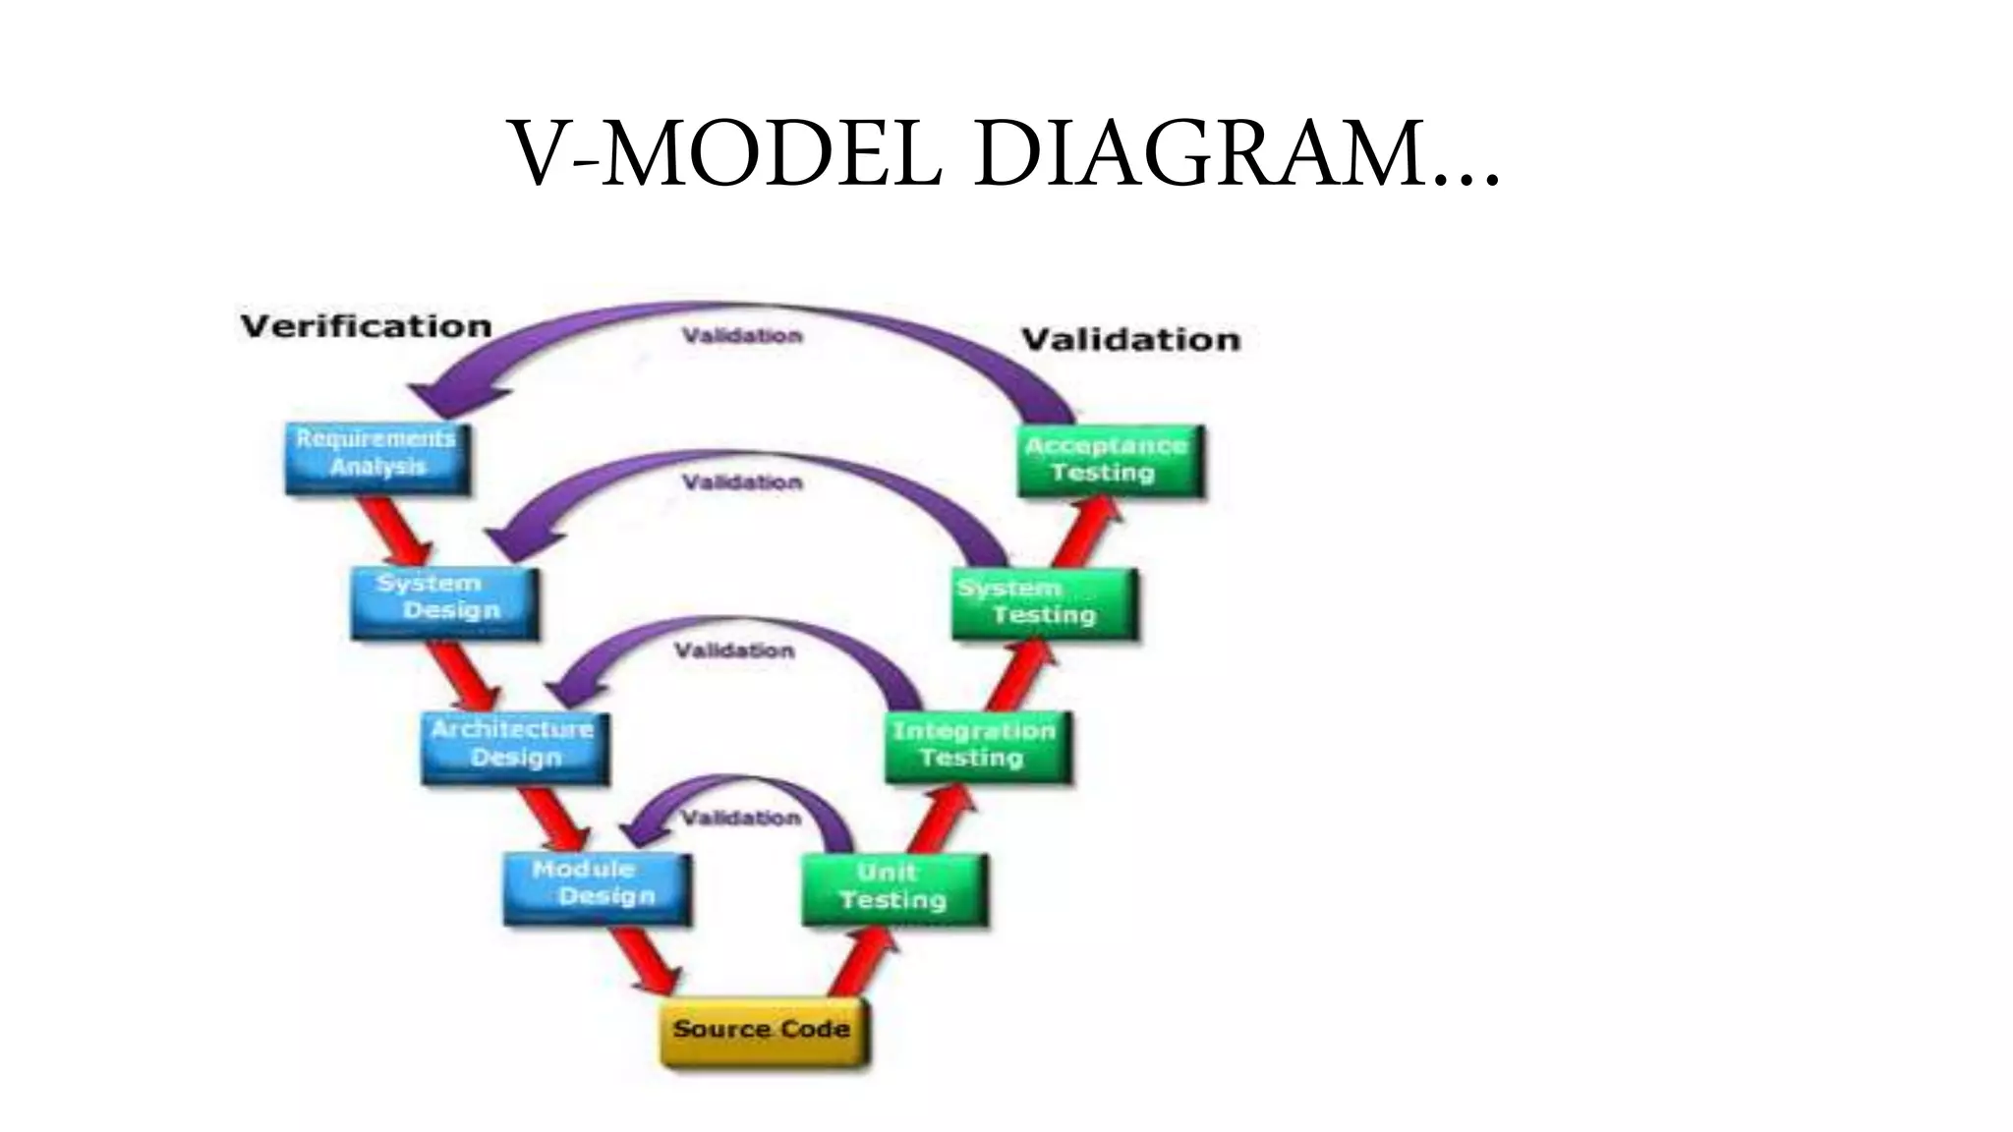

Slide 5
Different phase : Requirements
In this model the requirements are gathered before its development and a system test plan is created
The plan test focuses on meeting the functionality specified in the requirements gathering

Slide 6
The High level Design (HLD)
It focuses on system architecture and design
It provides overview of the solution ,platform system, product and services/process
An integrated test plan is created here as well as in order to test the pieces of the software system ability to work together

Slide 7
The Low Level Design (LLD)
Here the actual software components of software are design
Is defines the actual logic for each and every component of the system
Component test are created in this phase as well

Slide 8
Implementation
It is that phase where all the coding take place
Once the coding is complete the path of execution up the right side of the V where the test plans developed earlier are now put to use

Slide 9
Coding
This is at the bottom of the V-model
Module design is converted into code by developer

Slide 10
Advantages
Simple and easy to use
Testing activities like planning ,test design happens well before coding
This saves a lot of time
Avoids the down flow of the defects
Works well for small projects where requirements are easily understood

Slide 11
Disadvantages
High risk and uncertainty.
Not a good model for complex and object-oriented projects.
Poor model for long and ongoing projects.
Not suitable for the projects where requirements are at a moderate to high risk of changing.
Once an application is in the testing stage, it is difficult to go back and change a functionality.
No working software is produced until late during the life cycle.

